Slide 1


DevRel Camp
Connecting as One
Notes:
Accessibility review:
Slide Deck numbers should be added to each slide in the bottom right or left hand corner
Add Alt Text to all images

Slide 2




Data Platform Security Principals 101 DevRel Camp Feb 2021

Slide 3
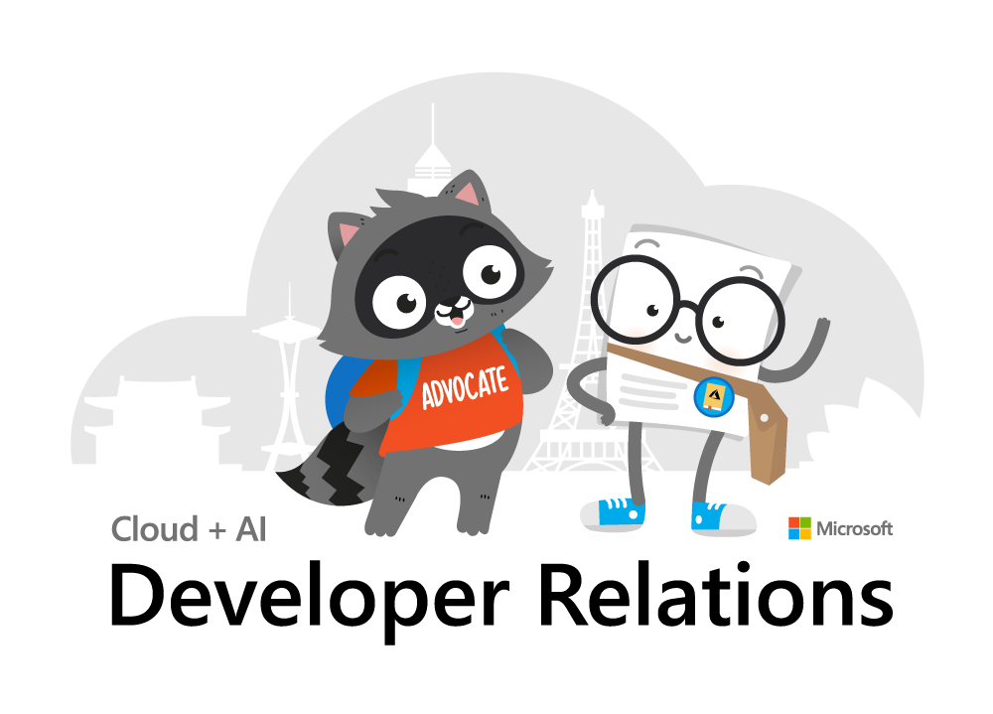
Inclusive Meeting Framework
Inclusive Meeting Framework Better experiences for everyone
Please practice these tips when in camp breakout sessions
Voice Guidance
Raise hand so the moderator can call on you.
State your name when speaking​ (every time).
Return to mute when not talking​.
Chat Guidance
Q: to preface questions
@mention to respond to an individual
Stay on topic
Use alt-text for images and gifs
Allyship
Seek to understand, not drive agreement.
Focus on ideas, not people.
Support & amplify peers​.
Avoid Acronyms
Created by Cory Fowler & Josee Martens https://aka.ms/bravespaces
Notes:
A reminder about our inclusive meeting framework, please mute now and if you have a question, raise your hand or mention it in Chat.
I am tight on content and want to wrap with my big finale SQL permissions demo that is a real crowd pleaser, so please hold all questions to the end.
We’ll have time for questions and I’d be happy to chat afterwards.
INTRODUCE our MODERATOR Laura Penney

Slide 4
Agenda
Security Principles
SQL Authentication and Logins
Role Based Access Control
Azure SQL DB Differences
Database Object Security
Demo
Notes:
Today we’re going to cover a lot of important foundational material about security, accounts, authentication. For folks new to Microsoft SQL Server security design and administration, this will be a great foundation.
But I think there is content in here to interest everyone at different levels of experience with SQL Server.
I’m focusing my content on what we in DevRel could take away when we’re building demos and tutorials, so we can demonstrate exemplary security. We don’t want our own walkthroughs scripting out shortcuts in security that end up in customer’s production systems.
Let’s get started!

Slide 5
Section Title 3
Authentication and Logins

Slide 6
Principal vs Principle
Principal
(noun) a person who is in charge of some responsibility
Example: The principal consultant talked to the school’s principal.
(adj) original, most important
Example: The principal aim of a good DBA is to defeat wicked developers.
Principle
(noun) a rule, guideline or fact
Example: Our guiding principles are based on science.
Notes:
So this is a common grammar issue in the English language, the difference between principal, P-A-L and principle, P-L-E.
Both can be a noun, but PAL describes a person, a person who could be your “pal”. A principle PLE is an inanimate thing, like guiding principles, or being principled.
So today, we’re really talking about both. Principals, PAL, are also what we call security objects in a database server. Principles, PLE, guide us.

Slide 7
A Principal’s Principles
We can all be Principled Principals
who follow Principal Principles of security.
Notes:
My title at my last job was Principal Consultant, so this past Principal is going to share with you his Security Principles.
And for this audience, I’m talking about the principles we principals demonstrate in our sample and walkthroughs.
<read slide>

Slide 8
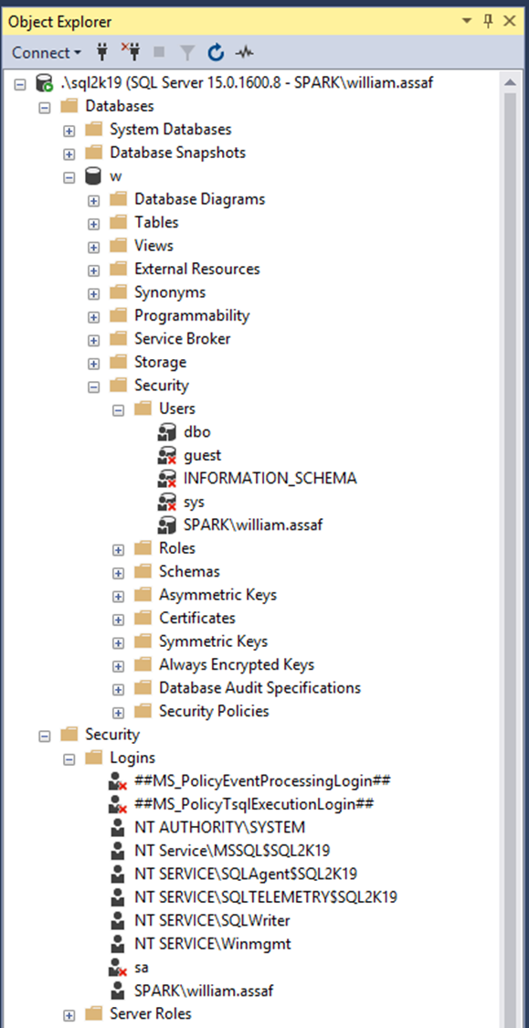
Login vs User
Database User
Server Login
Has a database context
Often linked to a Login*
Does not have a password*
Stored in a Database
Included in DB Restore
*Most of the time. We’ll talk about it.
Connects to a SQL Instance
Linked to AD (Windows Auth) or have a password (SQL Auth)
Stored in the Master system database, so is not included in other DB restores
Notes:
<read slide>
So over here in a screenshot from Object Explorer in SQL Server Management Studio, the Security folder under database has a subfolder for Users. The Security folder under server has a subfolder for Logins, and I’ve circled a login and a user here that have the same name.
So key takeaway here is that in SQL Server, logins handle authentication. Authentication can be through Active Directory, or as an alternative, internally via SQL Server authentication.
SQL Server authentication sounds simpler, contained, but we’ll talk about how that’s actually not advantageous for managing security.
Now, what have I already done wrong here?
I should create logins for to AD Security Groups, not individuals, not accounts with my name on it. Insist on it in tutorials, examples, walkthroughs.

Slide 9
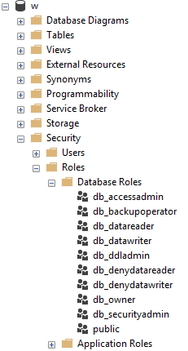
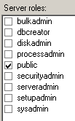
Server and Database Built-in Roles
Roles are security principals too.
Logins added to Server Roles.
Users added to Database Roles.
Built-in Roles to provide a standard for access that may be too broad.
Notes:
<read slide first, until too broad> When granting permissions to a database user, assign specific permissions when possible. While you can add a user to the built-in database roles, like db_datareader or db_datawriter, that might be overreach.
Your data within a database may not be homogenous in terms of sensitivity/permissions to access. Even a reporting login may not need access to everything in the database.

Slide 10

Public Roles
Every login/user is a member of “public”.
All logins/users inherit permissions granted to public.
Never grant permissions to a public role.
This is a red flag on any security audit.
Pay attention JEDI: This is STIG SV-53924r1_rule.
Notes:
<read notes instead>
On the sample image here, you’ll notice the server role public checkbox is always checked. And it can’t be unchecked.
Let’s talk briefly about the public roles.
Every login is a member of the public server role. Every user in each database is a member of that database’s public database role.
Only short-sighted developers would grant permissions to public, which allows every user - that does or ever will exist - to inherit permissions from public.
Permissions granted to a public role are a red flag, so never recommend it in any tutorials, walkthroughs, etc. In fact, there’s a STIG prohibiting this, if you’re into STIGS, these are audit findings the government and military use for security audits.
Source: https://www.stigviewer.com/stig/microsoft_sql_server_2012_database/2013-11-10/finding/V-41398

Slide 11

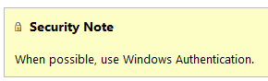
Windows Auth > SQL Auth
SQL Logins are authenticated by a SQL Server instance. Windows Auth Logins are authenticated against AD.
SQL Auth: “Enforce Password Policy” not required!
SQL Auth: More effort to maintain, migrate, secure.
Windows Auth: Easier to practice RBAC
Notes:
<read notes instead>
<click>
1. Now using SQL Authentication means each SQL Server is now an authority for its own credentials. If you have 10 SQL Server instances, that 10 different sets of logins and passwords to maintain, as opposed to one Active Directory.
<click>
2. You are strongly encouraged to Enforce password policy for SQL Authenticated Logins, which can include password expiration and complexity, inheriting from policy.
Unfortunately, in SQL Authenticated Logins, this is optional! Password could be password, empty string, or the same as the user name.
<click>
3. Multiple failed SQL Authenticated login attempts will cause a Login to become Locked Out, which a DBA must resolve.
<click>
4. Centralizing account and password management, role assignment, these are good things to do from a governance standpoint and from the standpoint of…. that thing you see on Certification Exams? “Least amount of administrative effort”
RBAC or Role Based Access Control is an acronym many in the governance area are familiar with, the idea that nobody gets permissions that are unique to them, they are only granted permissions based on their role, not their individual needs.
Role Based Access Control means that creating specific permissions is a meaningful exercise, because it’ll be applied to members of a group.

Slide 12
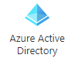
Role Based Access Control (RBAC)
Windows, AD, or preferably Azure AD makes this easier to accomplish.
Security groups already exist in Active Directory, let’s leverage them.
Most of this talk applies to all Azure SQL platforms.
Notes:
<read notes instead>
So Role-based access control is best when leveraging Active Directory, using security groups.
SQL Server Authentication can also be role based, but it exists within each SQL instance and is not a centrally managed security system, so it is not a scalable solution.
<click>
Security groups already exist in active directory, let’s leverage them. Let’s leverage AD or Azure AD to centrally manage the identities of database users in one central location.
<click>
A lot of what we’re talking about throughout this presentation applies to SQL Server, again whether it’s in a SQL Server instance on a VM in Windows or Linux or in Managed Instances, in all S.L.O.’s of Azure SQL DB, or in the SQL Server based nodes and pools of Big Data Clusters, Dedicated SQL pools, and Synapse.
Exceptions to this rule include Big Data Clusters, where SQL Authentication is the only option for SQL to SQL authentication inside the Cluster, and Azure SQL Edge, currently only supports the built-in SQL Authentication mechanism.
Note here I am not talking about Azure users and permissions used to secure Azure resources in the Portal or otherwise. Azure permissions are completely different than permissions inside a database, for good reason. Azure architects probably don’t need direct database access.
https://docs.microsoft.com/en-us/sql/big-data-cluster/concept-security?view=sql-server-ver15#encryption-in-flight-and-other-security-mechanisms

Slide 13

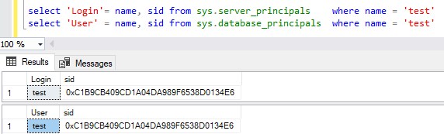

Logins + Users
A User can be linked to any Server Login
The names don’t actually have to match, but they should.
A SID (Security-IDentifier) is shared by User and Login.
Notes:
<Read notes instead>
Let’s talk a bit more about Logins and Users. I mentioned Users give Database Context to a Login. But how are they actually related?
<click>
Logins and Users are matched by a Security Identifier, or SID. The names don’t actually have to match, but they should.
Here you can see I’ve got a login and user with the same name but most importantly, with the same SID.
However, users can become orphaned from their logins if the SID’s don’t match. This most commonly occurs when restoring a database from one server to another, the user moves, but the login doesn’t.

Slide 14
Fix Orphaned SID
Only happens to SQL Authenticated logins.
To re-associate a database user to a server login:
ALTER USER username WITH LOGIN = loginname;
SELECT DBUser_Name = dp.name
, Login_Name = sp.name
FROM sys.database_principals AS dp
INNER JOIN sys.server_principals AS sp
ON dp.name = sp.name
WHERE sp.sid <> dp.sid;
Notes:
<read notes instead>
Now this only happens to SQL Authenticated Logins, one of the many drawbacks of SQL Authenticated Logins. That’s because SQL Auth Logins can get a different SID on each SQL instance.
This doesn’t happen to Windows Authentication accounts because that SID comes from Active Directory. So, in all SQL Servers, the AD logins have the same SID, so a user in a database can’t become orphaned if it’s moved to a new instance.
<click>
To fix an orphaned SID and reunite the Login with its User, the command is actually quite simple.
<click>
And you can also proactively identify orphaned logins by comparing their names and SID in SQL Server’s internal metadata.
For DBAs in the field, remembering to look for and fix orphaned SIDs is a necessary followup any time a database is restored from one server to another, for example, to update a dev or test environment from production.

Slide 15
Contained Databases
Moves authentication from the Server level directly to the Database level.
A contained database owner, for example, has full control over authentication to the database.
No server-level (or sysadmin) permissions necessary
Notes:
<read notes>
So again, we’ve been talking about the difference between Logins and Users and how the SID, not the name connects them. Now, don’t forget everything I just told you, but… well, there’s this thing called contained databases.
<click>
A Contained database moves authentication from the Server level directly to the Database level.
<click>
A contained database owner, for example, has full control over authentication to the database, with no server-level permissions necessary to manage it.
Contained databases have no configuration dependencies on the instance, it can be easily moved to another instance.

Slide 16
Users With Passwords
What a Contained Database means is that this syntax, which until now made no sense, is perfectly valid:
USE [Contoso_DB];
CREATE USER [BI_User] WITH PASSWORD ='strongpassword’;
--or
CREATE USER [Contoso\BI_User] FROM EXTERNAL PROVIDER;
Notes:
<read slide first, then notes>
So, this is that asterisk on my early slide, talking about how only logins have passwords, well, most of the time.
A contained database user is a database user… with a password.
or, contained database user can be directly tied to an AD Account.
Here in contained databases, the user is the method of authentication to the database, not the login.

Slide 17
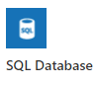
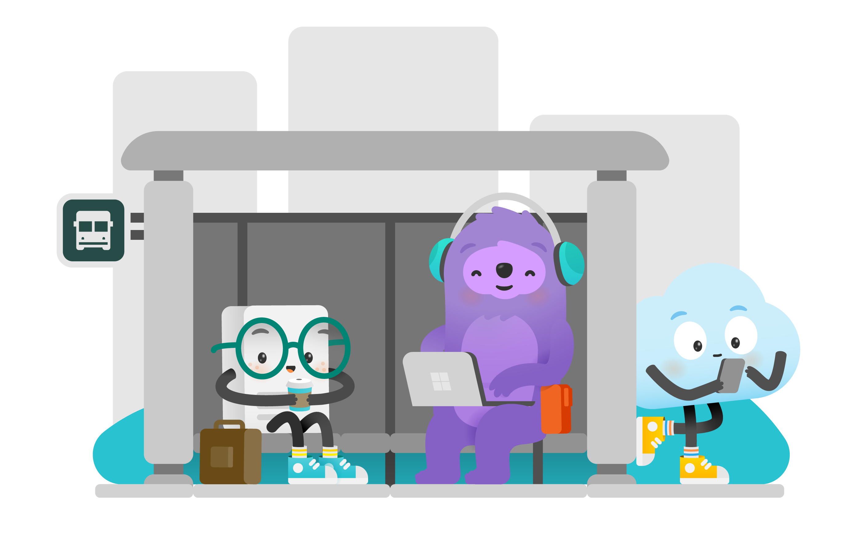
Contained Databases Sound Familiar
A platform where all the necessities for authentication and system objects are stored in the user database…
No system databases needed, so the database is easily portable between SQL instances…
What does this sound like?
Azure SQL Database!
Notes:
<read slide first>
This is the whole purpose of a contained database – unlimited portability on the back end, where Azure can move the database from instance to instance without having any ties to the instance, everything is contained inside the database, including authentication. You don’t know or care what instance your Azure SQL DB lives on, it’s completely contained and portable.
We also brought the contained database feature to SQL Server, where it’s actually labeled “partially contained” because of some minor details.
Let’s briefly talk about how the authentication and security principals here are different in Azure SQL Database from SQL Server.

Slide 18
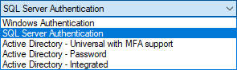
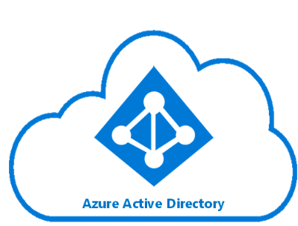
Azure SQL DB Authentication
Additional types of authentication since SSMS 2016
Image: https://docs.microsoft.com/en-us/azure/active-directory/hybrid/media/tutorial-federation/diagram.png
Notes:
The “Active Directory” dash options used for Azure AD only as Azure-based replacements for the Windows Authentication option.
You can of course use SQL Auth for an Azure SQL Database, and that’s really your first and only option for environment once it is created, before you have integrated Azure AD.
For all the same reasons as Windows Authentication for SQL Server, using the Azure AD authentication in Azure SQL DB is superior.

Slide 19
Azure SQL Admin Logins
Azure SQL DB Servers are logical servers only.
Azure SQL Logins in the master system database can be shared across databases.
You initially create one administrator SQL Auth login per Azure SQL logical server.
Notes:
<read notes instead>
Azure SQL DB <airquote> “servers” are logical servers only. And I say logical server because in the Azure SQL Database product, all the databases are contained. Unlike the master system database in SQL Server, the “master” system database in Azure SQL DB here can only store certain objects and is mostly read-only.
<click>
Just like in SQL Server, Azure SQL Logins can be created and linked to a SQL Authenticated user in a user database, if you have multiple databases in the logical server.
<click>
Initially, the admin account that you specify upon creating an Azure SQL DB exists as a SQL authenticated user, with administrative rights to all databases on the server.
That’s the only full admin login on the logical server that uses SQL Authentication, and you can’t create another.

Slide 20
Azure SQL DB + Azure AD
You can create one Azure AD administrator account with full admin permissions as well, via the Portal.
Only Active Directory accounts can create other Active Directory accounts in Azure SQL Database.
Notes:
<read notes instead>
You can create a second full administrator using Azure Active Directory, assigned via the Portal. Often, I see database folks adding their own Azure AD account as THE Azure Active Directory admin. Watch out for that antipattern, and again use Azure AD security groups for the role of the DBA or Database Developer as much as possible.
<click>
Once logged in as the Azure AD administrator, you can then add other Azure AD accounts as Azure SQL contained database users.

Slide 21
Database Object Security
Database Object Security
Notes:
Now I’m going to talk a little bit about database object permissions inside the database. I’ll assume you know the basics of GRANTing permissions, some of the basic read and write access permissions inside SQL Server as well. If you don’t, that’s ok, they’re obviously named. I’ll also assume you’re familiar with the table, the basic storage object of any relational database, where rows are queryable by end users. It’s the relationship between that data in the table, and the user’s end queries that I want to explore with a simple exercise.

Slide 22
Stored Procedures
Stored procedures require EXECUTE to run, and do not require underlying permissions (SELECT, INSERT, DELETE)
… assuming you don’t break one of these three rules:
1. the sproc doesn’t perform IDENTITY_INSERT on a table, which requires ALTER permissions.
2. all the underlying objects have the same ownership chain.
3. the sproc does not use dynamic sql commands like: exec sp_executesql @SQL or EXEC(@SQL)
Notes:
<read notes first>
Stored procedures are kindof a big deal, and we take them for granted. A big Synapse competitor, Snowflake for example, just straight up doesn’t have stored procedures.
<read slide, all three rules>
That last one is the big one, it’s the basic commands for executing strings of TSQL as dynamic SQL, this is a pretty big security no no and one common reason for why SQL injection attacks are successful. Stored procedures help insulate applications against SQL injection attacks. Even if you’re not a developer, everyone needs to be aware of what SQL injection attacks are because most public data entry forms and websites are under constant, automated SQL injection attacks.

Slide 23
Stored Procedures Security
Given those conditions, thanks to the database permission chain, you can:
GRANT EXEC rights to sprocs
GRANT no other permissions to the table!
Users can read/write data using sprocs ONLY.
Notes:
That way, no unauthorized SQL statements can be injected into the database via vulnerabilities in data entry forms.

Slide 24
User-Defined Functions
Similarly, a UDF will allow a user to SELECT data
Keep in mind the performance impact of functions can be severe. High potential for cursor-like effects.
New features in 2017 and 2019 addressed UDF performance
Notes:
Some of the performance issues with UDF’s were addressed in the last two releases of SQL Server.
In SQL 2017 the performance feature Interleaved Execution helped with performance of Table Value Functions.
In SQL 2019 the new scalar function in-lining feature helped reduce the negative performance impact of abused scalar User Defined Functions.

Slide 25
Views
Similar to sprocs
SELECT permission to query a VIEW will allow a user to SELECT data from table(s) without access to the tables.
GRANT SELECT ON [view] … is all you’d need.
Notes:
<read slide first, then notes>
(This is helpful!)
GRANT SELECT ON VIEW is all you’d need, instead of granting access to the underlying tables. In this way you can provide a horizontal or vertically partitioned view of data, excluding certain secure columns for example, or rows. This is a way to essentially perform row-level security. However, it’s not the only way.

Slide 26
Row Level Security
SQL 2016+ feature based on inline table-valued functions and a security policy.
Allows to you apply security policy to specific users, filtering specific tables.
Can block reads and writes against tables, without the use of triggers.
Notes:
<read notes>
This is a feature across all platforms, Azure SQL Database, Managed Instance, Azure Synapse Analytics, as well as SQL Server since SQL 2016.
<read slide>
This is useful, especially for reporting, but also for environments where databases have a variety of applications developed against them. You may have legacy databases with a mixed security environment of legacy and modern applications, perhaps low-code applications and mobile applications as well, and you want to help developers enforce a single, consistent row-level security policy at the database level.
https://docs.microsoft.com/sql/relational-databases/security/row-level-security

Slide 27
Demonstrate how Stored Procedures, Views, and Functions abstract the permissions necessary to SELECT underlying table data. Security p1.sql – logged in as sysadmin Security p2.sql – logged in as testing user
Notes:
This is a fun party trick to impress your friends and relatives and especially developers with your database security expertise.

Slide 28
Wrapup Section
Wrapup

Slide 29
More Resources
STRIKE trainings:
Cloud Security Incident Response Readiness Training
Security Foundations Training
Certification Exams:
Exam AZ-500: Microsoft Azure Security Technologies
Exam DP-203: Data Engineering on Microsoft Azure (beta)
Learn:
Security Overview - Azure SQL Database & Azure SQL MI
Securing SQL Server - SQL Server
Secure your data with Azure SQL - Learn

Slide 30
Thank you aka.ms/campfeedback

Slide 31

William Assaf
he/him
Senior Content Developer
SQL-Docs aka Rogue1
in/williamdassaf
@william_a_dba

